Slide 1
Quora Insincere Questions Classification
CS249 Advanced Seminar: Learning from Text – Spring 2019
Aashika Shetty
Kedar Deshpande
Shruti Sharan
Vidhu Malik

Slide 2
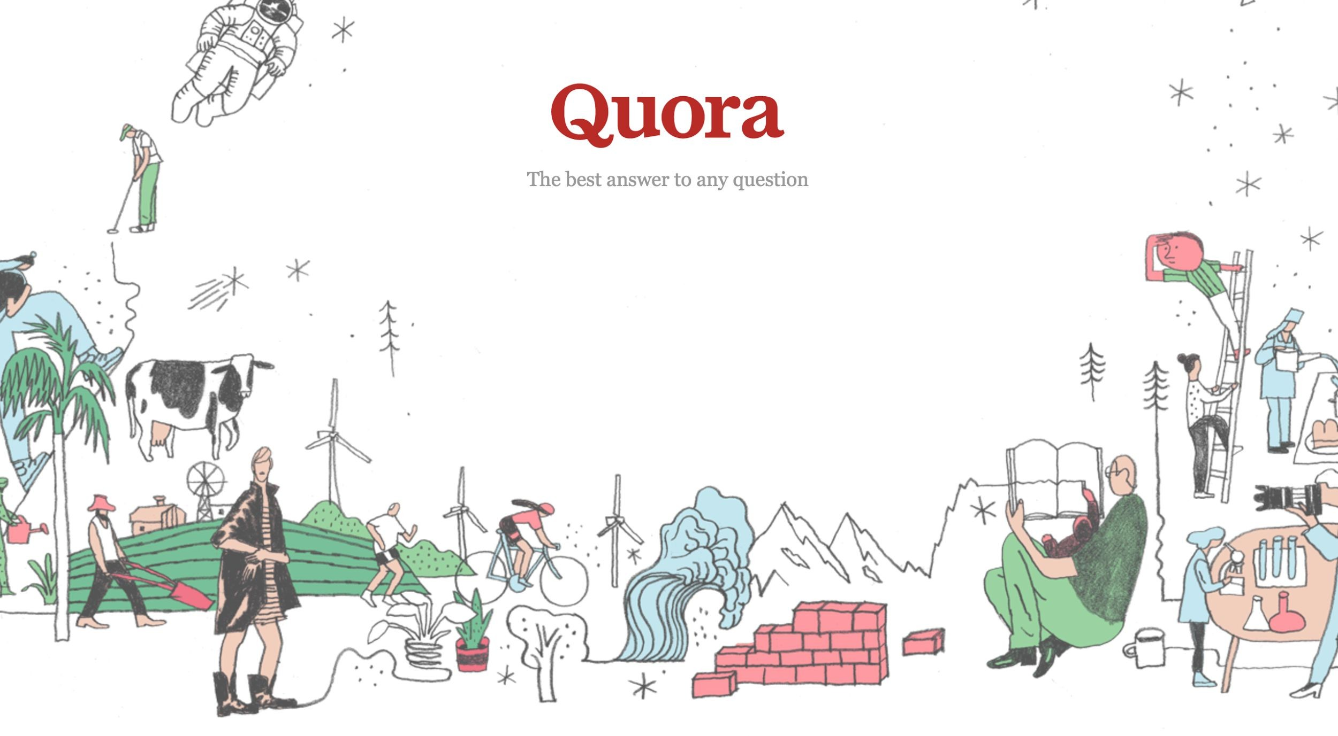

Slide 3

Problem Definition
To develop a system that can identify insincere questions present on Quora by developing models to detect toxic and misleading content
Notes:
On Quora, people can ask questions and connect with others who contribute unique insights and quality answers. A key challenge is to weed out insincere questions -- those founded upon false premises, or that intend to make a statement rather than look for helpful answers.
An existential problem for any major website today is how to handle toxic and divisive content. Quora wants to tackle this problem head-on to keep their platform a place where users can feel safe sharing their knowledge with the world.

Slide 4

Motivation
Quora
190 million unique visitors
Over 100 million people visit Quora every month
Caters to different communities, age groups
Questioning and Answering
Questions seeking factual answers
Hypothetical questions
Experiences of people
Opinions or surveys on topics
Insincere questions (Rants, trolls, biased opinions)
Detection of insincere questions
Subjective
Similarity with sincere questions
Understanding the intent is a benchmark task in NLP

Slide 5
What is an insincere question?
Insincere question: A question intended to make a statement rather than look for helpful answers
Has a non-neutral tone
Is disparaging or inflammatory
Isn't grounded in reality
Uses sexual content for shock value, and not to seek genuine answers
Notes:
Has a non-neutral tone
Has an exaggerated tone to underscore a point about a group of people
Is rhetorical and meant to imply a statement about a group of people
Is disparaging or inflammatory
Suggests a discriminatory idea against a protected class of people, or seeks confirmation of a stereotype
Makes disparaging attacks/insults against a specific person or group of people
Based on an outlandish premise about a group of people
Disparages against a characteristic that is not fixable and not measurable
Isn't grounded in reality
Based on false information, or contains absurd assumptions
Uses sexual content for shock value, and not to seek genuine answers

Slide 6


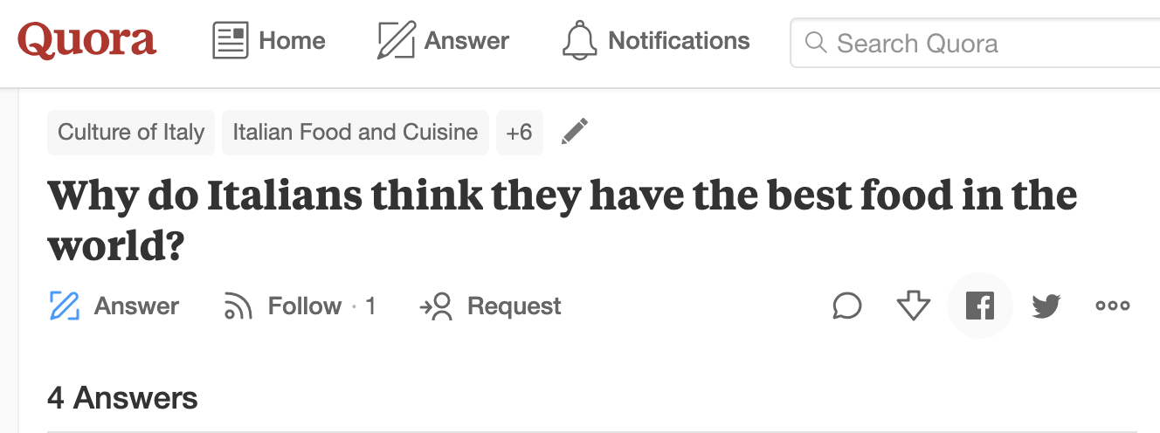
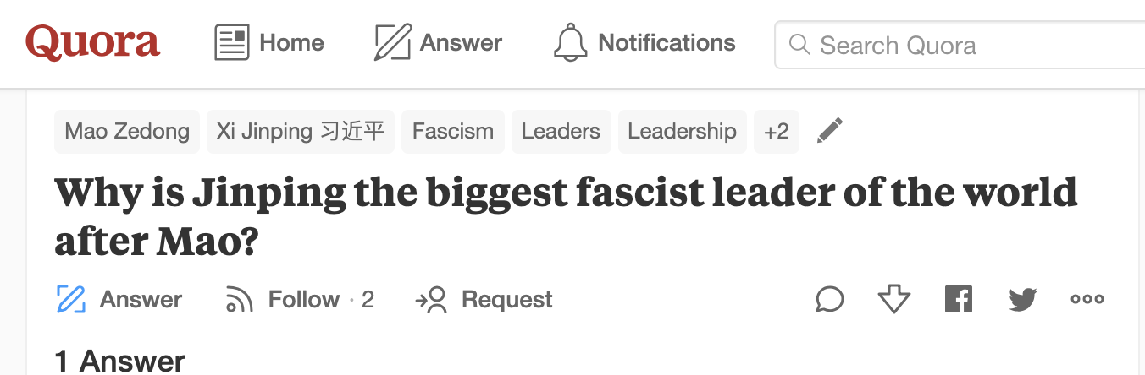

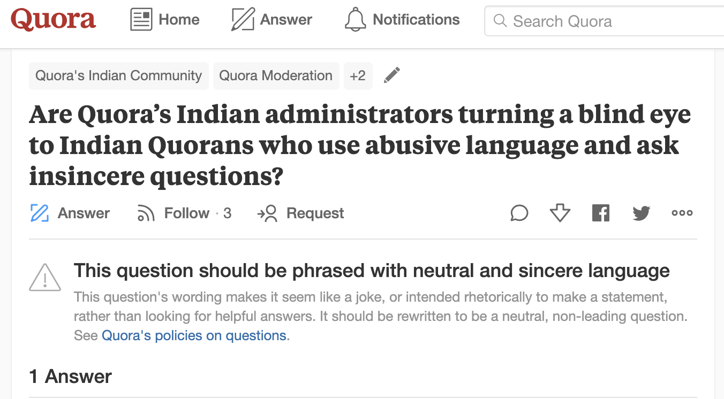
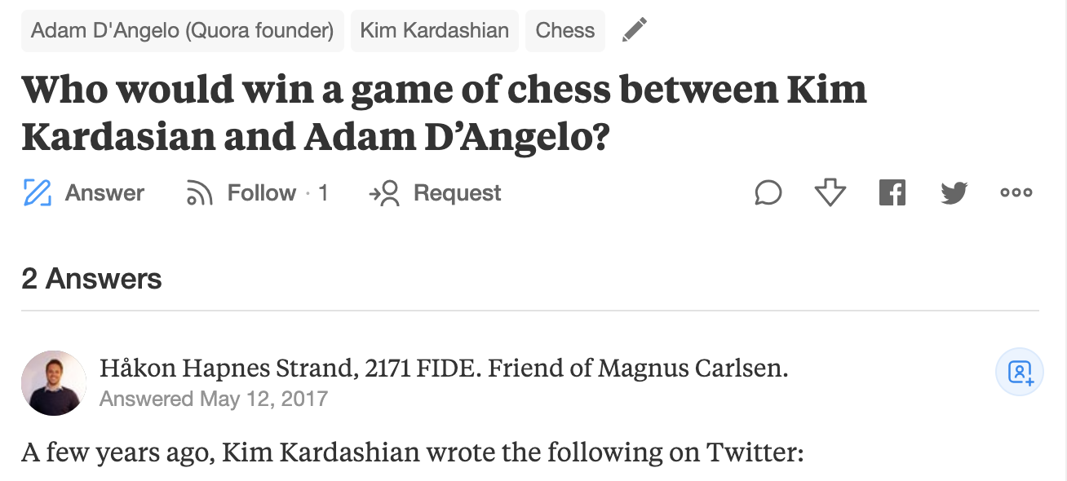
Examples of insincere questions

Slide 7
Dataset
Data fields
qid - unique question identifier
question_text - Quora question text
target - a question labeled "insincere" has a value of 1, otherwise 0
The training data includes:
the question that was asked
whether it was identified as insincere or not (Label = 1/0)

Slide 8
Dataset: Negative Examples
qid | question_text | target
00002165364db923c7e6 | How did Quebec nationalists see their province as a nation in the 1960s? | 0
000032939017120e6e44 | Do you have an adopted dog, how would you encourage people to adopt and not shop? | 0
0000412ca6e4628ce2cf | Why does velocity affect time? Does velocity affect space geometry? | 0
000042bf85aa498cd78e | Can I convert montra helicon D to a mountain bike by just changing the tyres? | 0

Slide 9
Dataset: Positive Examples
qid | question_text | target
0000e91571b60c2fb487 | Has the United States become the largest dictatorship in the world? | 1
00013ceca3f624b09f42 | Which babies are more sweeter to their parents? Dark skin babies or light skin babies? | 1
0004a7fcb2bf73076489 | If blacks support school choice and mandatory sentencing for criminals why don't they vote Republican? | 1
00052793eaa287aff1e1 | If both Honey Singh and Justin Bieber fall from the 5th floor, who will survive? | 1

Slide 10
Prior Art
Understanding the architectures proposed in the top solutions of the challenge
Identifying the distinguishing elements and important design decisions proposed
Some interesting solutions and their design choices:
Data Driven approach involving combination of upto 3 embeddings
Preprocessing heavy architectures involving extensive cleaning
Usage of attention mechanisms
Usage of Projection Meta Embedding and Exponential moving Average
Random Sampling in addition to Max Pooling
Bucketing and checkpoint ensembling
RNNs vs CNN models
Common choice: Importance of cross validation
Notes:
Our aim is to use the important components from several models and use a combination of these elements
Mention all various cleaning techniques

Slide 11
System Design
Preprocessing and Generating Embeddings
Used a Virtual Compute Engine on the Google Cloud Platform
High-end resources (52 GB RAM) to process huge amounts of data (~ 1.3 million questions)
Model Training and Evaluation
Used a Intel Xeon CPU 2.20Ghz, 8 cores
Used a NVIDIA Tesla K-80 GPU
Notes:
Our aim is to use the important components from several models and use a combination of these elements
Mention all various cleaning techniques

Slide 12
Word Embeddings
Used pre-trained word-embeddings
Main Advantage : No training phase involved
Embeddings chosen: Pre-trained vectors trained on part of GoogleNews corpus (~ 100 billion words)
Contains 300-dimensional vectors for 3 million words and phrases
Interface to word2vec: Python package called gensim
Open-source library for natural language processing
Includes streamed parallelized implementations of most word embeddings - FastText, word2vec and doc2vec algorithms
Notes:
Our aim is to use the important components from several models and use a combination of these elements
Mention all various cleaning techniques

Slide 13
Data Preprocessing
Unconventional method - no stemming/stopword removal
Helps Neural Network Models to learn better - information is retained
Tried to get our embeddings as close to the vocabulary as possible
Applied a check on vocabulary coverage of embedding after every new preprocessing function
Preprocessing function:
purge_str: Removes punctuation
purge_num: Removes numerals
obtain_misspellings: Get misspellings in the questions
substitute_misspellings: Edit the misspellings
Notes:
Our aim is to use the important components from several models and use a combination of these elements
Mention all various cleaning techniques

Slide 14
Novel Representation - List of OrderedDict Objects
Read each question and split into words
Assign each word with corresponding Embedding Vector (dim = 300)
Create OrderedDict Python object for each Question
Append each OrderedDict object to a list
Easy access of embedded vector for each word in a question
[ OrderedDict(“What”: <embedded vector>, “is” : <embedded vector>, “hypothermia” : <embedded vector>, “?” : <embedded vector>), OrderedDict(...), ...]
Notes:
Our aim is to use the important components from several models and use a combination of these elements
Mention all various cleaning techniques

Slide 15
Approach
Data Preprocessing
Word embeddings
Core Architecture:
Bi-LSTM
Convolution layers
Bi-GRU
Model Optimization
Adam Optimizer
Dropout
Evaluation
F1-measure
Notes:
Standard techniques: spell check, removal of stop words, to lower case, stemming and lemmetization etc
word embeddings: word2vec, glove, paragram, elmo, bert
Model Optimisation: cross validation, batch normalisation, dropout, hyper parameter tuning
DImension reduction: Spacial dropout, Maxpooling, importance sampling, PCAd

Slide 16
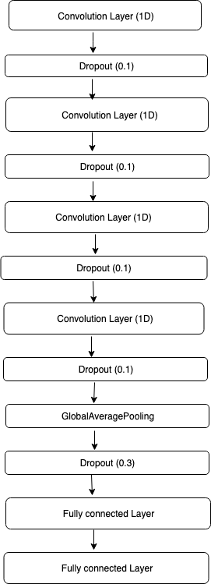
Model 1: 1D CNN
Batch Size: 2048
Question Size truncation: 30
Training set: 56%, Testing Set: 30%, Validation set: 14%
Activation: Tanh
Number of filters: 128
Dropout: 0.1
Optimiser: ADAM
Loss: Binary Cross Entropy
Testing metric: Accuracy
Epochs: 1
Notes:
Though the dataset was much larger, we worked with a smaller subset of 200,000 questions due to computational restrictions
train 112000 test 60000 val 28000
Tried activation relu, but tanh performed better

Slide 17
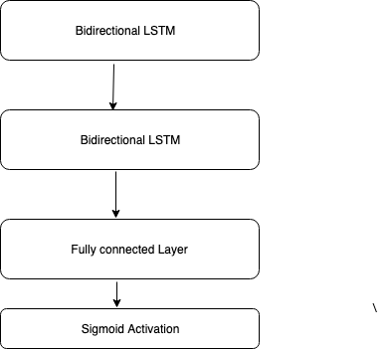
Model 2: BiLSTM
Batch Size: 128
Question Size truncation: 30
Training set: 56%, Testing Set: 30%, Validation set: 14%
Optimiser: ADAM
Loss: Binary Cross Entropy
Training metric: Accuracy
Testing metric: Accuracy
Epochs: 20 (No of steps:1000)

Slide 18
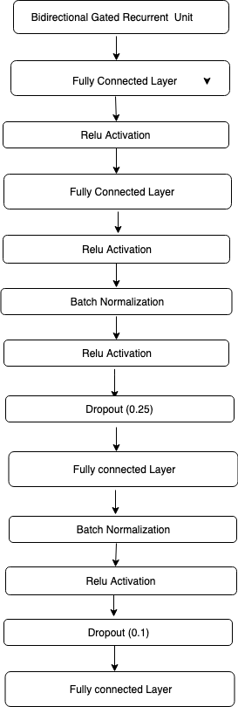
Model 3: BiGRU
Batch Size: 128
Question Size truncation: 30
Training set: 56%, Testing Set: 30%, Validation set: 14%
Optimiser: ADAM
Dropout: 0.25
Batch Normalisation
Activation: RELU
Optimiser: ADAM
Loss: Binary Cross Entropy
Epochs: 20 (No of steps:1000)

Slide 19
Evaluation and Results
In the statistical analysis of binary textual classification we used Accuracy to evaluate our model both for training and testing.
Model | Train Accuracy (%) | Test Accuracy (%)
BiLSTM | 94.13 | 94.35
BiGRU | 94.83 | 96.2
CNN | 95.09 | 95.17
Notes:
Recall
Precision

Slide 20
Questions?

